Slide 1


Data Integration and Knowledge Discovery with the International Shark Attack Database
July 26, 2016 ITCS 6265 Summer 2016

Slide 2
Research Team
Sailesh Bhamidipati
Sonal Kaulker
Pown Arthi Thimiri Dayasagar
Jai Kiran Duvvu
Dr. Pamela Thompson

Slide 3
Statement of Purpose
The objective of this research is to improve our understanding of the presence of sharks
during tourist seasons in middle Atlantic and south eastern coastal waters, specifically
North Carolina and South Carolina. Our study will focus on the analysis of existing data
from the International Shark Attack database, weather and water data from NOAA,
calculated moon phase dates, fish, crab and turtle populations. The quantitative
analysis on this data will lead to new and interesting knowledge that may provide the basis
for an app providing advanced information on the likelihood of sharks in coastal waters
where tourists swim, surf and wade.
An additional focus of this research is to analyze social media activity relative to
shark presence. Tweets will be mined with specific data ranges and locations in order
to assess social media activity with respect to shark sightings, attacks, and even activities
that are related to shark presence such as schools of fish. Once the nature of this
activity is understood, a recommendation for a standardized way to tweet
will be considered with interested and strategic partners in order to ultimately provide an
additional feed to the app described above.

Slide 4

The process: CRISP-DM Cross Industry Standard Process – Data Mining

Slide 5
Domain Understanding Summer of 2015 brought a record number of attacks.
Summer of 2015 – many attacks
Researchers described “perfect storm” of conditions relative to many theories:
Population – lots of tourists, increased human activity
Moon phases – this is disputed
Weather, global warming
Water conditions
Shark preservation efforts
Fish migration (food source)

Slide 6
Domain Understanding
"Every time we go to the beach, we are invading a natural world that is already occupied by animals and plants in that area. We need to remember that when we enter the sea it's not the equivalent of going to the YMCA pools . . . It's a wild world out there.“
George H. Burgess, director of the International Shark Attack File at the University of Florida's Florida Museum of Natural History

Slide 7
Domain Understanding
"The population has been going up and the number of people going in the water is always increasing. The risk of any shark bite is already incredibly low—far less likely than drowning or many other rare risks. But, the more people you have going into the water, the better the odds are that something bad is going to happen, whether it's a shark bite or getting pulled under on a riptide.”
Dr. Chuck Bangley, ECU Shark Researcher
(from http://www.scientificamerican.com/article/shark-bites-are-up-but-attack-risk-is-down/)

Slide 8
Domain Understanding
Visit http://www.profthompson.net for interesting articles and resources related to shark attacks

Slide 9
Domain Understanding
George Burgess also mentions parts of North Carolina have been abnormally dry or have experienced moderate drought conditions for several weeks.
The salinity, or salt content, of ocean water close to shore is higher than usual, which is being cited as a possible reason for the surge in the shark attacks.
Baby and other sea turtles may draw sharks to the North Carolina shores.
Is it the warming ocean causing the sharks to follow prey that are migrating due to warmer temperatures perhaps caused by climate change?
The annual migration of menhaden fish, a favorite shark food, appears linked to water temperature, which jumped 10 degrees in a week during the heat wave of 2015 (Burgess, Scientific American)
What is true? What are the other factors? Is there hidden knowledge that can be discovered?

Slide 10
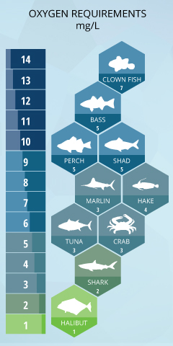
Domain Understanding: Water
Salinity, Turbidity, Oxygen, Sea Water Temperature from East Cribbing Station in NC (used for all data, average readings during frequent attack times)
Oxygen: Gulf coast experiences “dead zones” caused by low oxygen levels due to fertilizer run off
Suspected as cause of higher shark attacks due to low fish populations
Daily measure included in our research

Slide 11
Domain Understanding: Weather
Temperature, Precipitation, Moving Average Precipitation, Wind Speed, Wind Direction
Daily readings from NOAA
Daily measures included in our research
Sharks like warmer weather, will migrate as seasons change
People go to the beach when it is hot

Slide 12
Domain Understanding: Crabs
Sharks eat crabs.
Crabs have more frequent movement during full and new moon phases.
Crab landings data for NC (daily) is available courtesy of Alan Bianchi, North Carolina Division of Marine Fisheries

Slide 13
Domain Understanding: Turtles
Sharks eat turtles
NC and SC have many nests
Turtles move from ocean to beaches for nesting and false crawl (they go to beach but don’t lay eggs)
Turtle data for NC and SC courtesy of
Michelle Pate and Dr. Matthew Godfrey, State Coordinators, SC and NC Wildlife Resources Commissions
Privacy and security concerns are always important!

Slide 14
Domain Understanding: Moon Phases
Moon phases affect water levels
Full moon and new moon cause levels to rise higher than normal during tides
Effect starts 2-4 days before a phase and extends 2-4 days after
Spring tides happen when the sun and moon are on the same side of the earth (New Moon) or when the sun and moon are on opposite sides of the earth (Full Moon).
One study shows no effect: http://benthamopen.com/contents/pdf/TOFISHSJ/TOFISHSJ-6-71.pdf

Slide 15
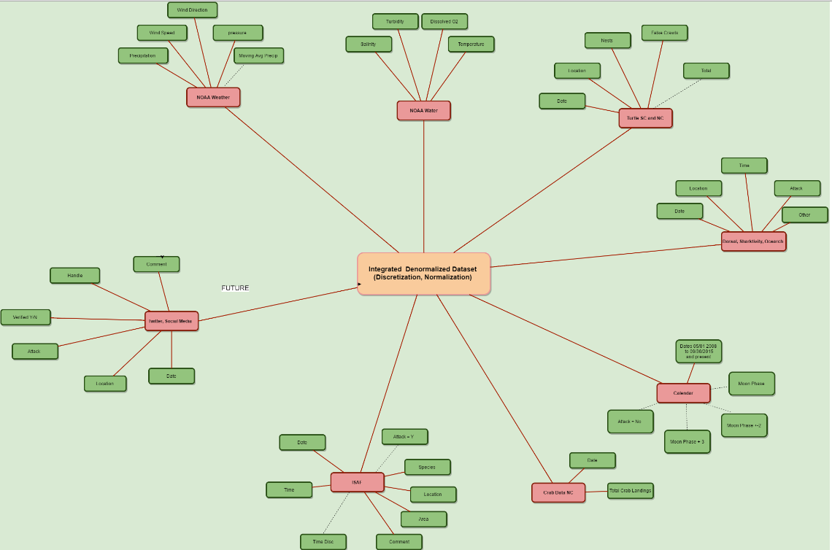
Data Preparation

Slide 16
Data Preparation
Numeric values: Discretized, Normalized for new attributes (3 bin)
Precipitation: 5 day moving average added
Moon phases: extended for Full, New Moon
Crab Data: For attack = Y, added by date
Crab Data: For attack = N, Necessary imputations were made
NOTE: Class imbalance problem! Handled with stratified sampling of Attack=No
Subset so that 1/3 of records remain with adequate representation for each date.

Slide 17
Modeling:
Exploratory Data Analysis
FIRST ROUND: with the discretized data base using R, WEKA
Classification: Naïve Bayes
Clustering: Simple EM (Expected Maximization)
Association Rule: Apriori
NOTE: See github http://www.github.com/AKDDResearch/Shark-Attack for complete
Source of data and files for this research

Slide 18
Modeling: Classification (discretized dataset, reduced dimensionality)
Naive Bayes:

Slide 19
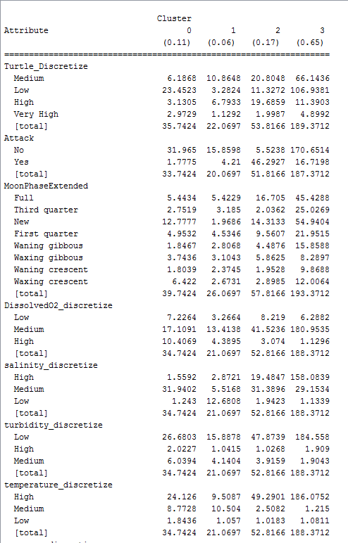
Modeling: Clustering
Simple EM (Expected Maximization)

Slide 20
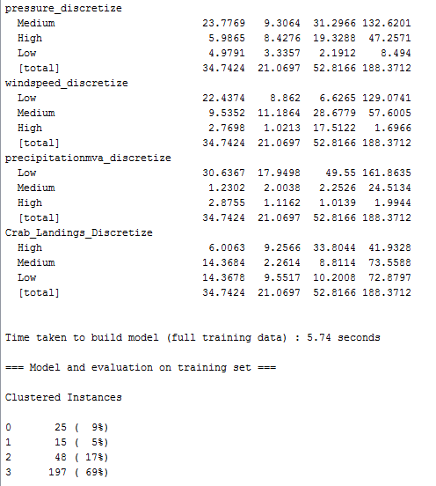
Modeling: Clustering
Simple EM (Expected Maximization)

Slide 21
Modeling: Association Rule Mining
As water temp and salinity increase, Dissolved oxygen levels decrease. Temp and Salinity removed for Association Rule Mining. Best rules:
5. MoonPhaseExtended=New DissolvedO2_discretize=Low 7 ==> Attack=Yes 7 conf:(1)
11. Turtle_Discretize=High MoonPhaseExtended=New 6 ==> Attack=Yes 6 conf:(1)
18. MoonPhaseExtended=New DissolvedO2_discretize=Low turbidity_discretize=Low 5 ==> Attack=Yes 5 conf:(1)
Dissolved Oxygen levels and “jubilee” effect: http://oceanservice.noaa.gov/education/kits/estuaries/media/supp_estuar10d_disolvedox.html

Slide 22
Association Rule Mining

Slide 23
Preliminary Results
Attributes that are interesting:
Turbidity
Turtle Discretized
Moon Phase
Temperature
Wind Speed
Wind Direction

Slide 24
Twitter Hash Tag Analysis

Slide 25
Recommendations
DATA – continue to improve the data collection and analysis with location awareness where possible (we used East Cribbing data for both NC and SC)
Attributes of interest:
Weather: Wind speed, Direction, Temperature, Turbidity
Environment: Crab Landings, Turtles
Sightings: A feed from social media, as close to real time as possible (need better classifier)
Other sources: coordination with apps, rescue personnel, beach patrols
STANDARDIZED HASH TAG
Collaboration (https://twitter.com/DorsalAus, Sharktivity, other researchers)
Publicity
Use:
Shark sightings (see @sharkreports, @dorsalau on Twitter)
Turtle activity
Schools of fish (draw sharks)
CONTINUED STUDY
Research – work on binnings, class imbalance, Chlorophyll A, fish, social media feed
COLLABORATION – shark researchers
App for warnings, sightings – collaboration with DORSAL, others
Grant

Slide 26
Recommendations
Some Considerations
Will better awareness of conditions and sightings affect tourism? (Dr. Craig Depken, Economics at UNCC, investigating media reports of attacks and tourism
Will individuals try to “game” the system?
Are we ever able to say it is “safe” to swim?
How about liability?

Slide 27
Questions?
"Our results indicate that investing in increasing and communicating our understanding of the behavior, distribution and ecological role of sharks as well as the factors influencing the risk of shark bites, may ultimately be the most effective way to increase safety of people. If people learn to avoid being near shark food during feeding times, we become far less likely to end up an as accidental appetizer.”
Dr. Francesco Ferretti, Stanford, commenting on a recent study in http://www.scientificamerican.com/article/shark-bites-are-up-but-attack-risk-is-down/

Slide 28
Selected References
Scientific American: Shark Bites are Up, But Attack Risk is Down? http://www.scientificamerican.com/article/shark-bites-are-up-but-attack-risk-is-down/
Hashtag Standards for Emergencies: https://docs.unocha.org/sites/dms/Documents/TB%20012_Hashtag%20Standards.pdf
Lunar Cycle Effects: http://benthamopen.com/contents/pdf/TOFISHSJ/TOFISHSJ-6-71.pdf
What 3 Words: http://what3words.com/
Dr. Pamela Thompson blog: http://www.profthompson.net
Dorsal app: https://www.dorsalapp.com/
Sharktivity map and app: http://www.atlanticwhiteshark.org/sharktivity-map/
http://www.profthompson.net – Shark Research

